Slide 1

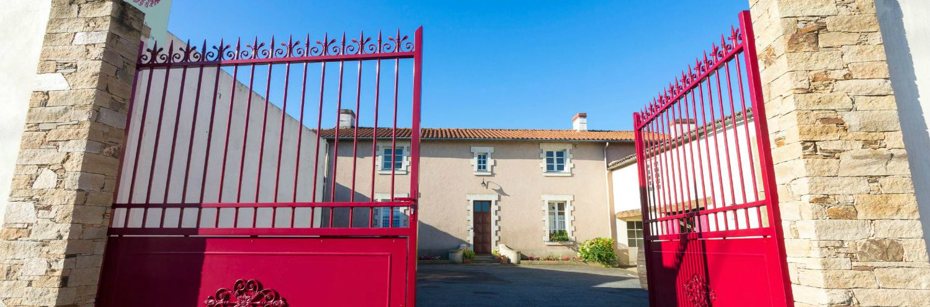
“Bringing out the quintessence of our terroirs”

Slide 2

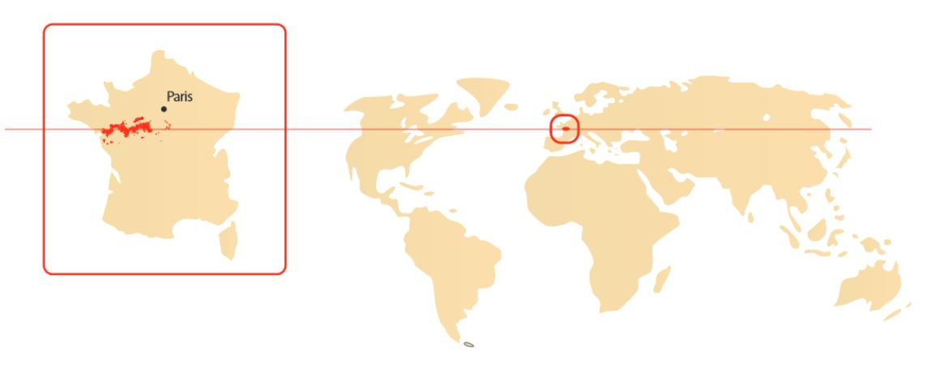
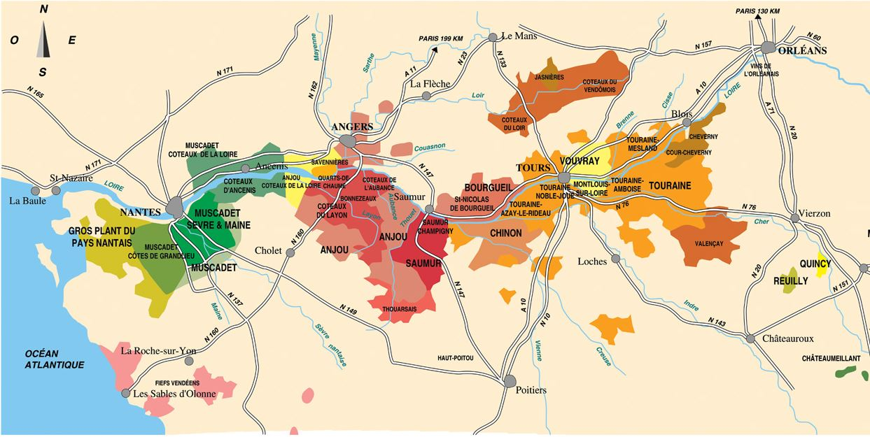
Location
At the confluence of the rivers Sèvre and Maine, in the Loire Valley,
the 35 ha vineyard Domaine Martin is rooted in the heart of the
Muscadet Sèvre et Maine AOC.
Saint Fiacre sur Maine
•
•
Domaine Martin

Slide 3
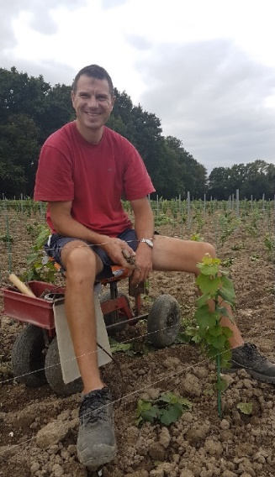

History
Sole credo : timelessness
Nowadays, the Domaine is run by Dominique Martin, the 4th generation of winegrowers.
Like his elders, he uses the latest techniques along with traditional know-how, from vine growing to bottling his main AOC : Muscadet Sèvre et Maine.
Sales have been growing in France and internationally since 1952, mainly to professional customers.
1st bottling by Emile Martin.
1901
1945
1952
1978
Since 1999 ...
Léon Bernard buys the « maison de la Garnière », current premises of the Domaine Martin.
Léon Bernard’s daughter, Marie, marries Emile Martin.
Emile Martin’s son, Bernard, takes over the Domaine.
Bernard’s son, Dominique, runs the Domaine.

Slide 4
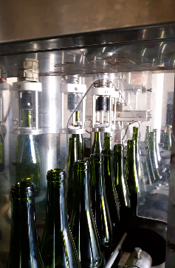
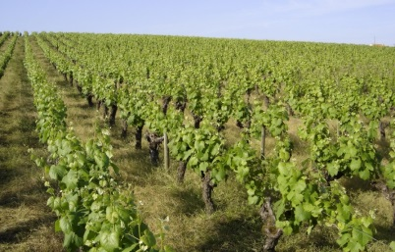
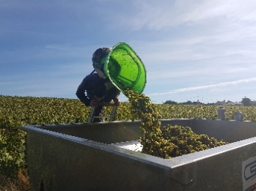
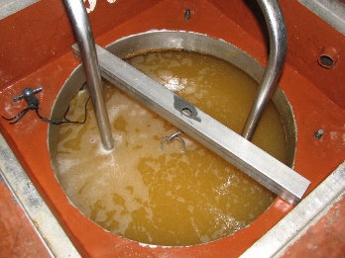
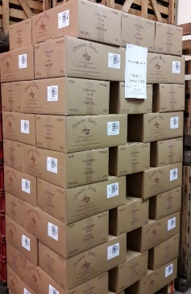
Quality Charter
Independence and Reactivity
Our organisation and investments make us independent throughout the whole process, and allow us to meet our commitments.
1- Planting and growing the single variety Melon B. on gneiss slopes
2- Harvesting at appropriate maturity to reveal the fine aromas of the AOC Muscadet Sèvre et Maine
3- Making wine and maturing “on lees” in underground tanks
4- Bottling at the Domaine
5- Packing and releasing within the allowed time

Slide 5
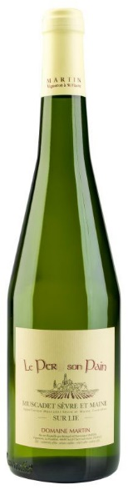
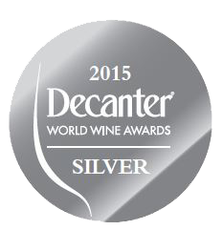


AOC Muscadet Sèvre et Maine sur Lie
« Le Per son Pain »
« Le Per son Pain » is our best-seller.
In the past, farmers used to work hard on the poor soil of the plot named « Le Perd son Pain », but harvested very little : they were “losing their bread”. Nowadays, the vine is flourishing thanks to deep rooting.
This pebbly gneiss soil suits the Melon B. grape variety, which is first mechanically harvested.
The robe is light and brilliant yellow.
Winemaking “on lees” reveals harmonious fresh fruit aromas and crisp minerality.
“Le Per son Pain” is naturally fruity, elegant and delicately iodized.
75 cl bottle
Case of 6 or 12 bottles
Wine area: Val de Loire
Type of wine: dry white wine
Grape Variety: 100 % Melon B.
Winemaking: on lees for at least 8 months
Alc. Vol.: 12 %

Slide 6
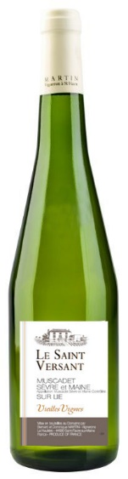

AOC Muscadet Sèvre et Maine sur Lie
« Le Saint Versant »
“Le Saint Versant” is made from vines around 70 years old.
These vines are particularly well exposed. Combined with low-volume production, grape ripening is perfect.
Gneiss subsoils and upper layers of clay give this Muscadet a distinguished minerality.
Following manual harvesting, winemaking is carried out traditionally “on lees”, in underground tanks.
This wine is light and crystalline yellow.
Mineral smell reveals fine aromas of white flowers.
When tasting, this Muscadet is well-balanced, with a rich fruity elegance, and a hint of freshness.
“Le Saint Versant” is recognizable by its persistency.
75 cl bottle
Case of 6 or 12 bottles
Wine area: Val de Loire
Type of wine: dry white wine
Grape variety: 100 % Melon B.
Winemaking: on lees for at least 10 months
Alc. Vol.: 12 %

Slide 7
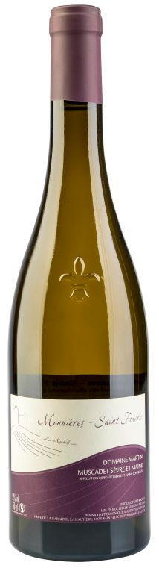
AOC Muscadet Sèvre et Maine
« Le Rochils »
The “Cru” Monnières - Saint Fiacre is in the process of becoming a “Communal” appellation of Muscadet .
The plot named « Le Rochils » has been selected among the best gneiss slopes, located between the rivers Sèvre and Maine.
This soil gives low yields. Advanced ripeness is pursued.
Grapes are harvested and sorted manually.
Long fermentation and maturing with stirring enhance the aroma profile.
When tasting, “Monnières - Saint Fiacre” offers generous structure and mineral complexity.
The robe is delicate gold yellow.
The smell of ripe fruits promises great consistency.
The palate is ample, with a rich balance, bringing out a refined and powerful terroir.
75 cl bottle
Case of 6 or 12 bottles
Wine area: Val de Loire
Type of wine: dry white wine
Grape variety: 100 % Melon B.
Winemaking: on lees for at least 30 months
Alc. Vol.: 12 %

Slide 8
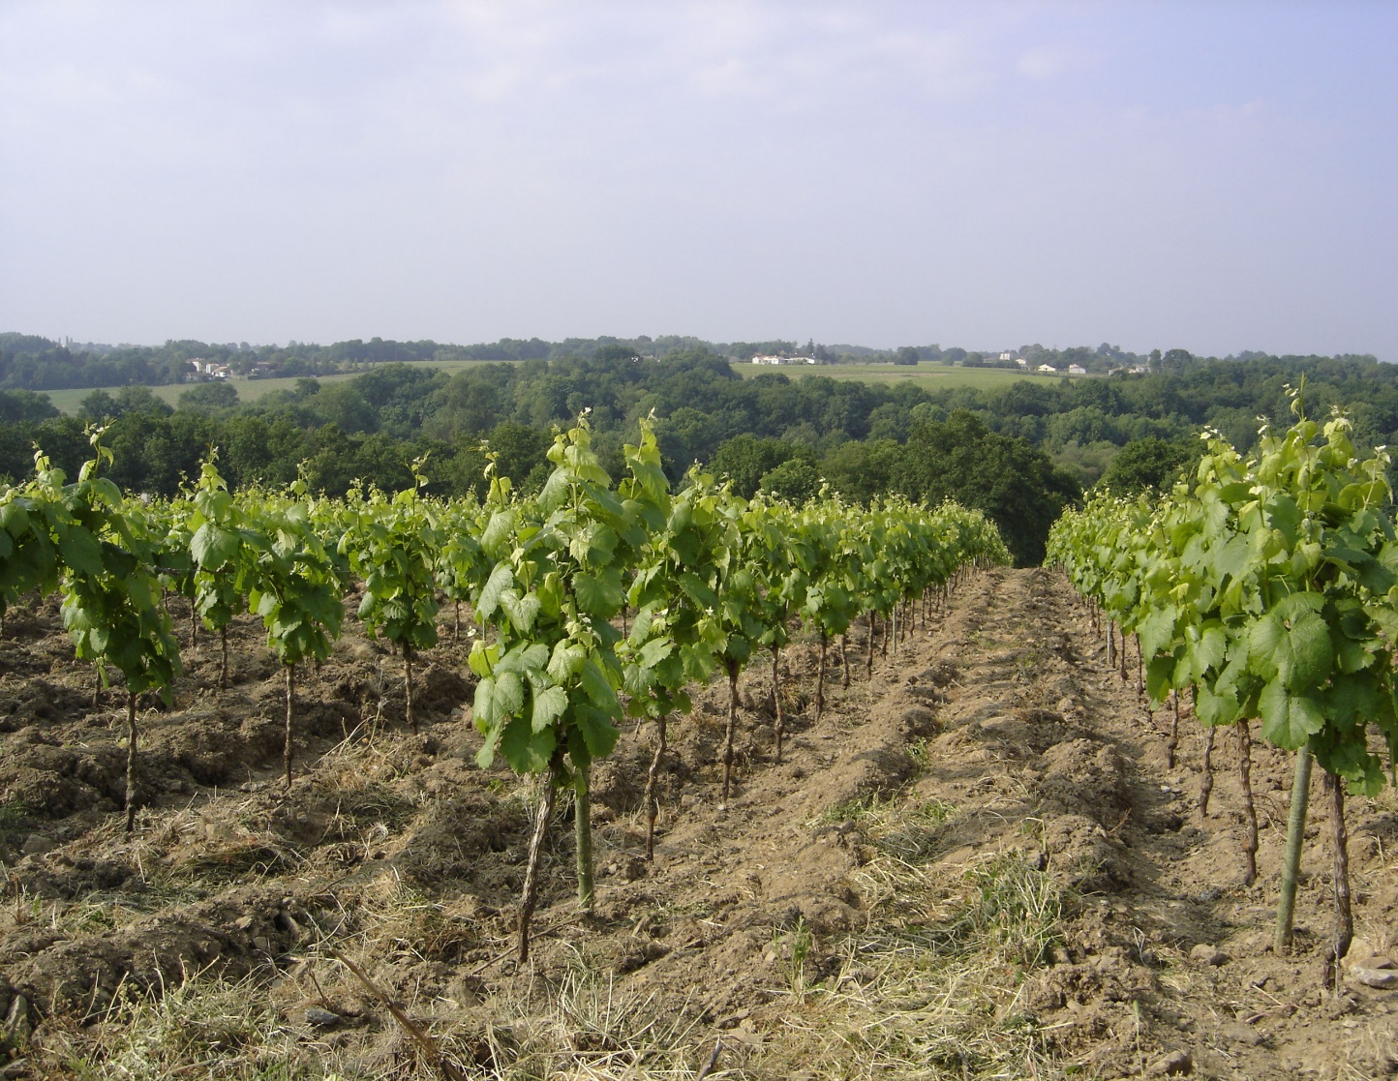
Dominique Martin - Owner Vigneron
Karine Lequien - Export Manager
6 rue de la Garnière
La Hautière
44690 Saint Fiacre sur Maine
France
Tel : +33 (0)2 40 54 81 49
export@martin-bernard.com
www.martin-bernard.com

